Slide 1



Okan Cetinkaya
Junior Data Analyst Task Presentation

Slide 2
About Data
Modifications
Analysis methods
Task I: Tonnes of waste by material group
Task II: Which three local authorities collected the most waste
Task III: Which local authorities collect aluminium cans
Further insights and exploratory data analysis
Links
References

Slide 3
About Data
8 Columns x 81312 Rows

Slide 4
About Data
8 Columns x 81312 Rows
Local Authority
Items
Adur District Council, Allerdale Borough Council, Amber Valley Borough Council..
Green glass, Waste food only, WEEE - TVs & Monitors…
Date Period
ColText
Apr 20 - Jun 20, Jul 20 - Sep 20, Oct 20 - Dec 20, Jan 21 - Mar 21
Tonnage collected for recycling
QuestionNumber
Tonnes Collected
Q010
QuestionText
Material Group
Tonnes of material collected through kerbside schemes from household sources by LA or its contractors
Glass, WEEE, Metal…

Slide 5
Modifications
Changed "Cambridge City and South Cambs s" to "Cambridge City and South Cambs”
Changed "of the Isles of Scilly" to “Isles of Scilly”.
Replaced "-" between dates with "to".
Added District, County, Country columns.

Slide 6


Analysis Methods
Pivot Tables
Pandas
Formulas
Numpy
INDEX, MATCH, GETPIVOTDATA etc.
Matplotlib
Charts
Column, Line, Maps etc.

Slide 7

Task I: Tonnes of waste by material group
Material Groups | Sum of Tonnes collected
Co-mingled | 3,675,944.51
Organic | 3,431,883.10
Paper & Card | 561,704.00
Glass | 314,132.46
Plastic | 48,663.09
Metal | 25,701.43
WEEE | 12,614.06
Other Materials for CVar Calcs | 3,005.12
Textiles | 2,369.45
Wood | 2,048.59
Bulky | 1,919.83
Furniture | 795.77
Batteries | 244.80
Composite | 188.66
Tyres | 174.11
Rubble | 54.38
Oil | 48.97
Plasterboard | 28.46
Other Materials | 0.416
Soil | 0
Paint | 0
Grand Total | 8081521.20

Slide 8
Task II: Which three local authorities collected the most waste
Local Authority | Sum of Tonnes collected
Buckinghamshire Council | 99712.36
Cheshire East | 97325.77
Somerset Waste Partnership | 89905.02

Slide 9
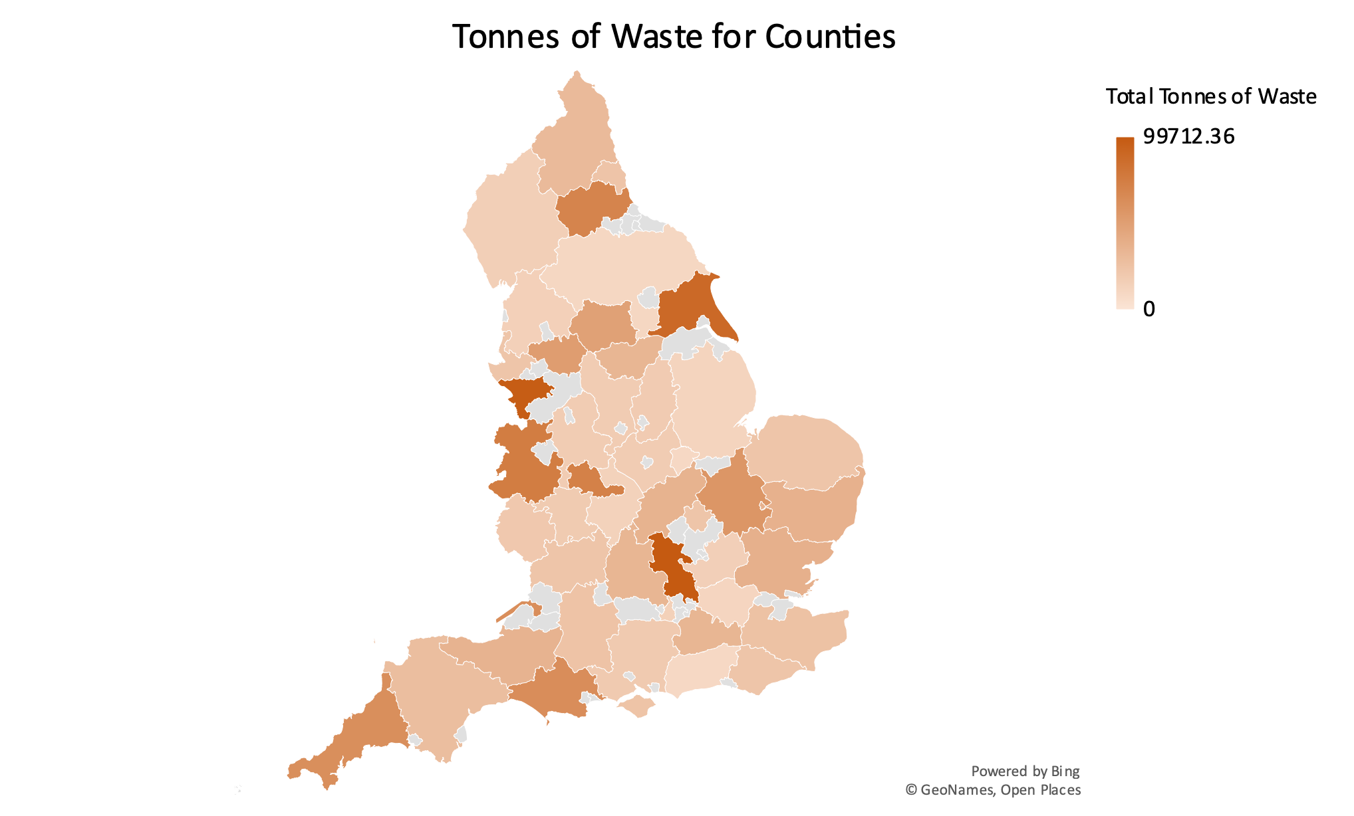
Task II: Which three local authorities collected the most waste
Local Authority | Sum of Tonnes collected
Buckinghamshire Council | 99712.36
Cheshire East | 97325.77
Somerset Waste Partnership | 89905.02

Slide 10
Task III: Which local authorities collect aluminium cans
Local Authority | Sum of Tonnes collected
Somerset Waste Partnership | 986.08
Cheshire West and Chester | 649.38
Bath and North East Somerset Council | 382.78
North Somerset Council | 371.78
Chelmsford Borough Council | 310.94
East Devon District Council | 274.71
York City Council | 263.74
Hounslow LB | 247.28
Torbay Council | 182.66
North Devon District Council | 168.53
North West Leicestershire District Council | 166.60
Teignbridge District Council | 128.82
Cheltenham Borough Council | 125.04
Mid Devon District Council | 105.62
Warwick District Council | 102.36
Torridge District Council | 54.84
Grand Total | 4521.18

Slide 11
Further insights and exploratory data analysis
More waste is collected in spring and summer than in autumn and winter
Jan 21 to Mar 21 |  | Apr 20 to Jun 20 |  | Jul 20 to Sep 20 |  | Oct 20 to Dec 20
Mean | 26279.14 | Mean | 33984.65 | Mean | 33994.04 | Mean | 28189.46
Median | 3.93 | Median | 10.09 | Median | 10.12 | Median | 9.26
Standard Deviation | 121529.09 | Standard Deviation | 144193.32 | Standard Deviation | 143313.81 | Standard Deviation | 123654.27
Maximum | 939053.07 | Maximum | 942487.58 | Maximum | 891373.12 | Maximum | 903030.74
Sum | 1734423.08 | Sum | 2242986.80 | Sum | 2243606.97 | Sum | 1860504.36

Slide 12
Further insights and exploratory data analysis
“Green garden waste” and “mixed garden and food waste” are more abundant in spring and summer, when people are more interested in their gardens, compared to other seasons.
Item | Jan 21 to Mar 21 | Apr 20 to Jun 20 | Jul 20 to Sep 20 | Oct 20 to Dec 20
Green garden waste only | 255161.55 | 650198.34 | 714254.03 | 406278.56
Mixed garden and food waste | 147226.62 | 293326.59 | 276482.85 | 183716.09

Slide 13
Further insights and exploratory data analysis
Of the 10 local authorities where most textiles are collected, 4 are located in the county of Greater London.
Local Authority | County | Tonnes of Collected Textiles | % of Collected Textiles
Wandsworth LB | Greater London | 459.68 | 27.37
Hammersmith and Fulham LB | Greater London | 248.45 | 14.79
Southend-on-Sea Borough Council | Essex | 187.91 | 11.19
Royal Borough of Kensington and Chelsea | Greater London | 167.33 | 9.96
Croydon LB | Greater London | 128.16 | 7.63
Cheshire West and Chester | Cheshire | 122.27 | 7.28
Rochdale MBC | Greater Manchester | 116.815 | 6.95
Swindon Borough Council | Wiltshire | 91.71 | 5.46
Calderdale MBC | West Yorkshire | 81.5 | 4.85
Bath and North East Somerset Council | Somerset | 75.86 | 4.52
Grand Total |  | 1679.685

Slide 14
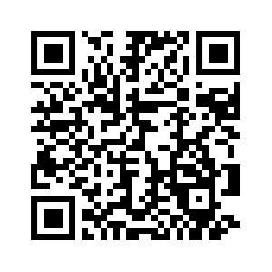
Links
GitHub

